Slide 1
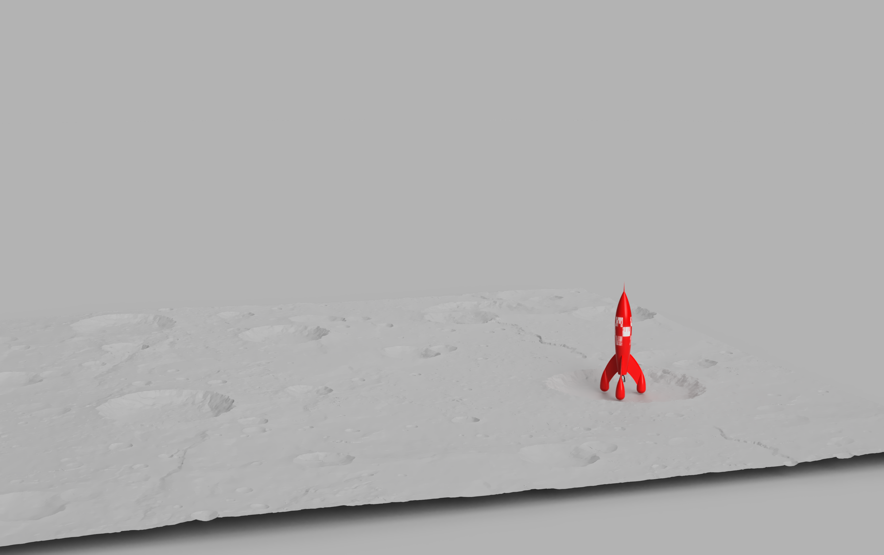
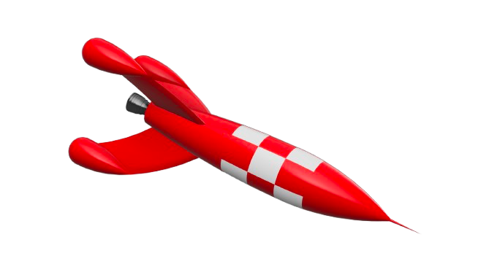
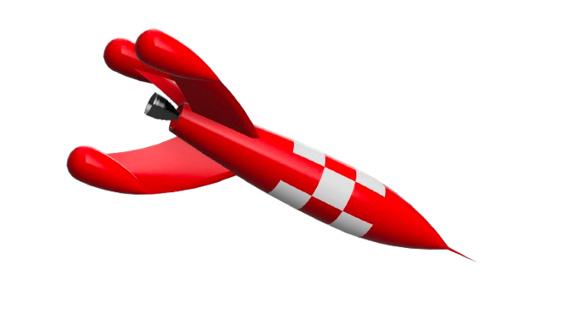
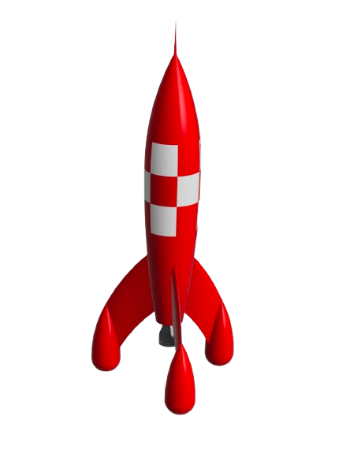
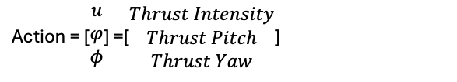
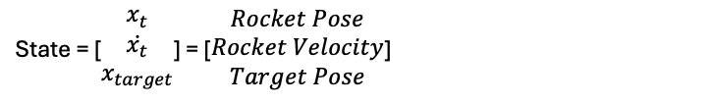
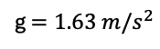
1. Entry
Pitch
2. Flip and Attitude Capture
Yaw
State = [$\begin{matrix}x_{t} \\ \dot{x_{t}} \\ x_{target}\end{matrix}$] = [$\begin{matrix}Rocket Pose \\ Rocket Velocity \\ Target Pose\end{matrix}$]
Action = [$\begin{matrix}u \\ φ \\ φ\end{matrix}$] =[$\begin{matrix}Thrust Intensity \\ Thrust Pitch \\ Thrust Yaw\end{matrix}$]
3. Terminal Landing Burn
g $=1.63 m/s^{2}$
Ideal Landing Location

Slide 2
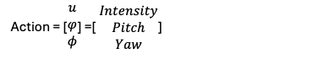
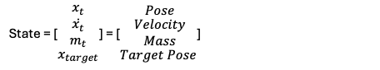
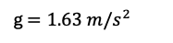
1. Entry
2. Flip and Altitude Capture
State = [$\begin{matrix}x_{t} \\ \dot{\begin{aligned}x_{t} \\ m_{t}\end{aligned}} \\ x_{target}\end{matrix}$] = [$\begin{matrix} Pose \\ \begin{aligned} Velocity \\ Mass\end{aligned} \\ Target Pose\end{matrix}$]
Yaw
Pitch
3. Terminal Landing Burn
Action = [$\begin{matrix}u \\ φ \\ φ\end{matrix}$] =[$\begin{matrix} Intensity \\ Pitch \\ Yaw\end{matrix}$]
g $=1.63 m/s^{2}$
Ideal Landing Location

Slide 3

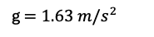
1. Entry
2. Flip and Altitude Capture
Initial State = [$\begin{matrix}x_{t} \\ \dot{\begin{aligned}x_{t} \\ m_{t}\end{aligned}} \\ x_{target}\end{matrix}$]
3. Terminal Landing Burn
g $=1.63 m/s^{2}$
Ideal Landing Location

Slide 4
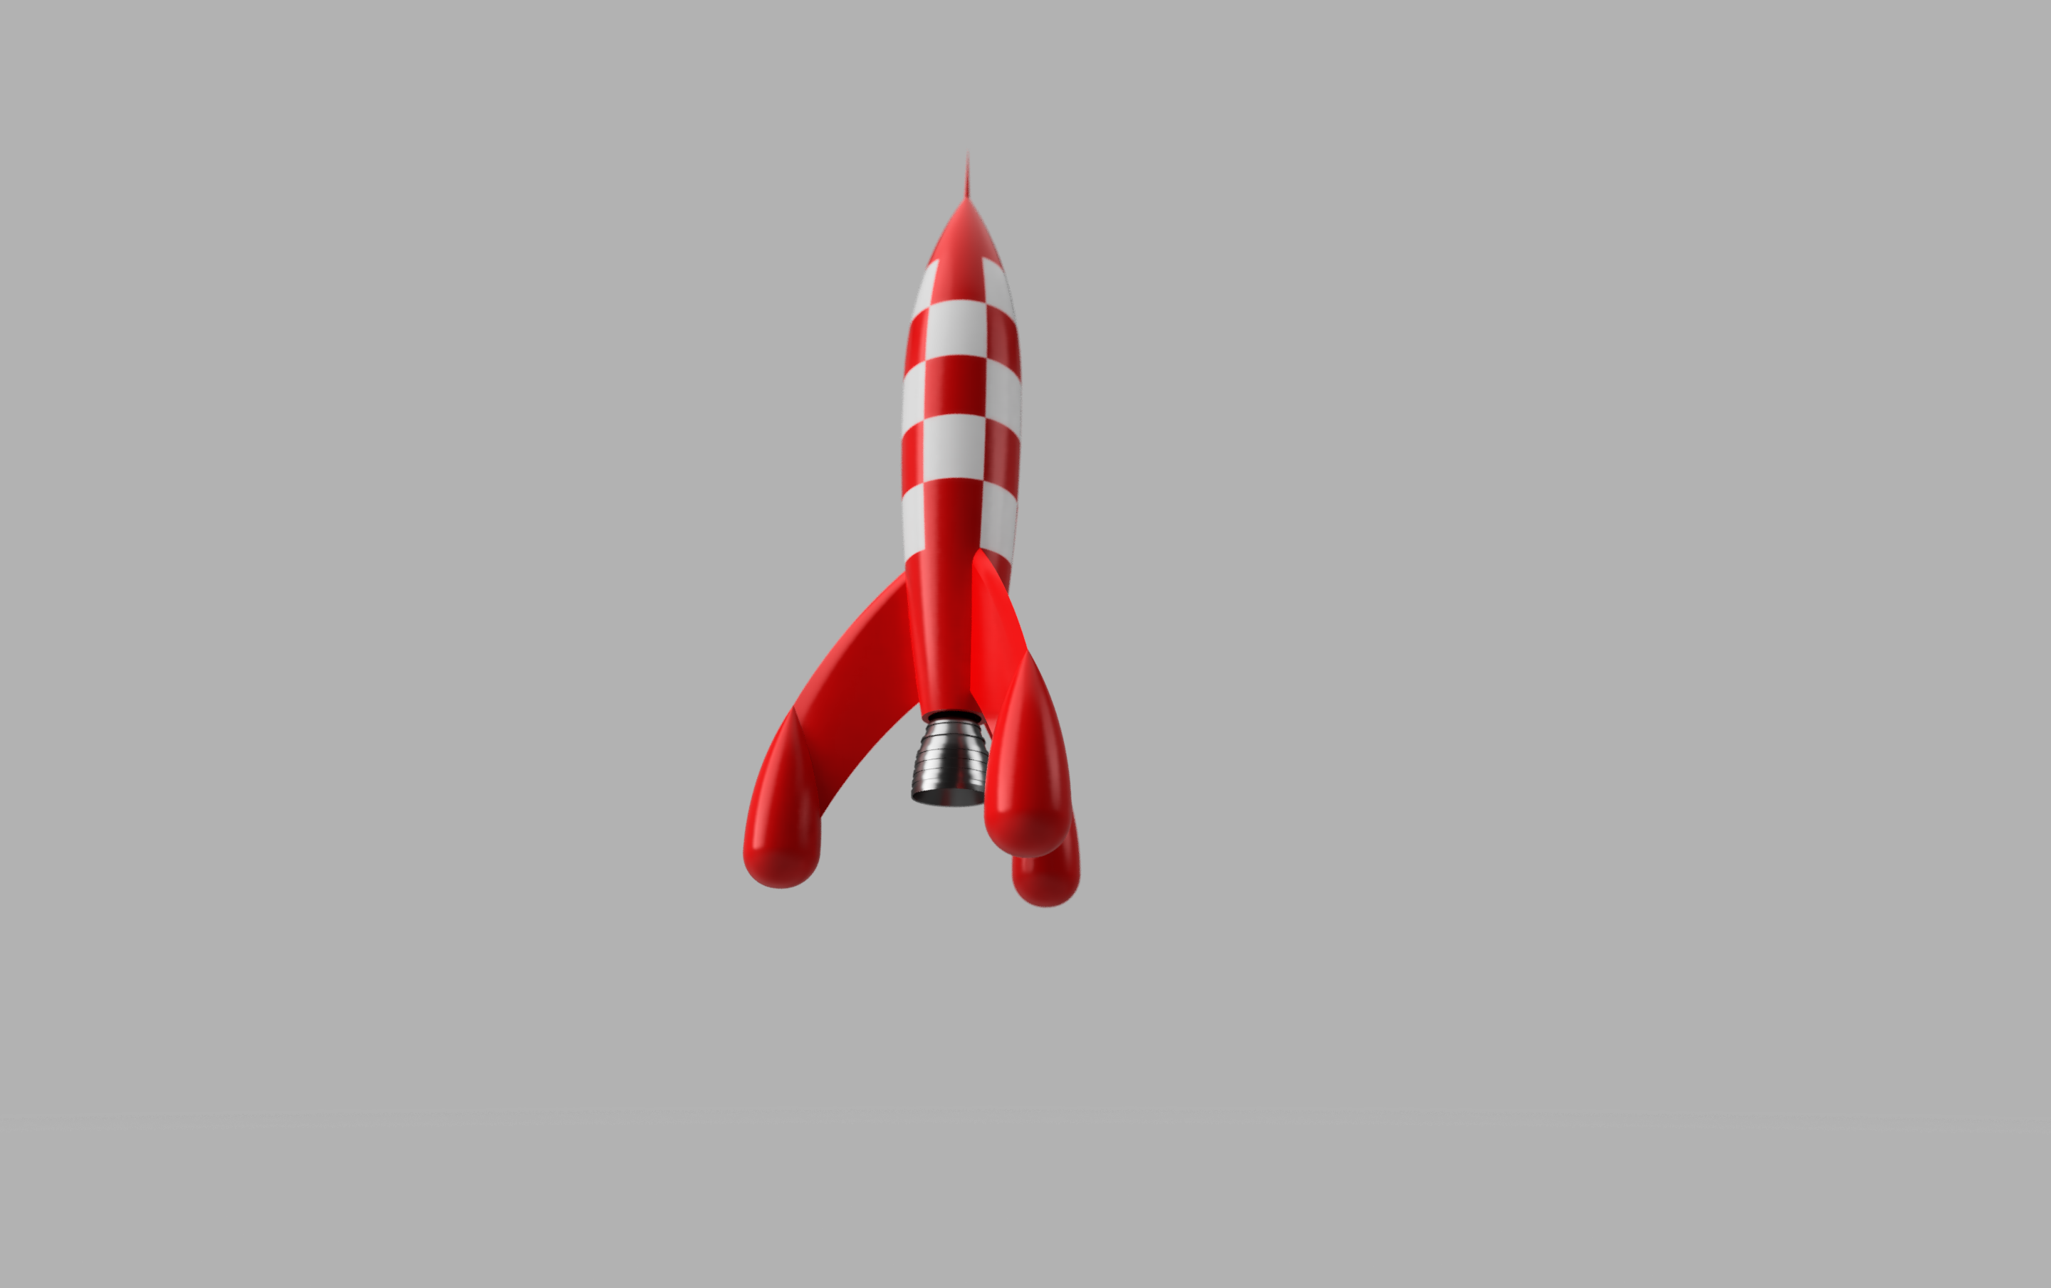
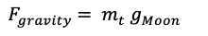
$F_{gravity}$ $= m_{t} g_{Moon}$
Flying Direction
CoM
Rocket Inertia Frame
h
Drag
Gravity
Target Frame
d
Pitch
Roll
Thrust Frame
Thrust
World Frame

Slide 5
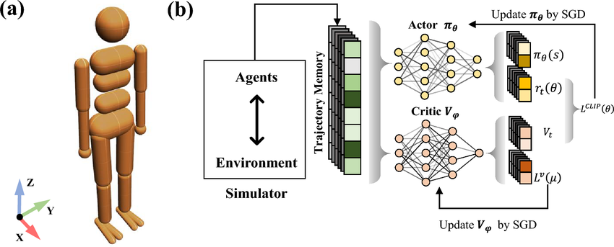
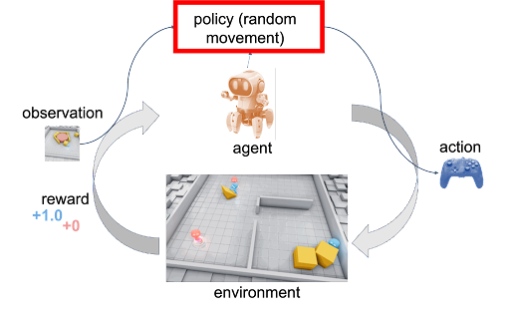
Got it—let’s make the figure scream “RL-controlled landing.” Here are tight, practical upgrades you can add right now:
Show the RL loop (mini inset)
Tiny block diagram inset (top-right): Observations (IMU, altimeter, velocity, attitude, position error) → Policy πθ → Actions [throttle, gimbal-pitch, gimbal-yaw] → Dynamics → next state. Add a thin arrow from the inset back to the rocket to imply it’s running every step.
Visualize the actions along the path
Throttle bar: a slim vertical bar riding with the rocket ghost; fill height ∝ thrust (0–100%).
Gimbal cones: small translucent cone from the nozzle showing thrust direction; cone tilt = √(pitch²+yaw²).
Action arrows: short vector arrow at a few key frames labeled (T, θp, θy).
Phase-specific RL objectives (labels on the background bands)
Entry (Guided Descent) – reward terms: ( -|\mathbf{v}_\perp| ), fuel economy.
Flip & Attitude Capture – ( -|\text{attitude error}| ), smoothness penalty ( \Delta u^2 ).
Terminal Landing Burn – ( -|\mathbf{p}-\mathbf{p}^*| - |\mathbf{v}| ), soft landing bonus, touchdown upright.
Safety & constraints (make it credible)
No-go envelope: a faint corridor (dashed) around the trajectory = safety set; shade “unsafe” outside.
Actuator limits: tiny captions near the nozzle, “±15° gimbal, Tmax = 500 kN”.
If you use a shield (CBF/MPC), add a tiny badge: Safety shield ON (clamps actions when necessary).
State & uncertainty
Estimation trace: duplicate the final path with a hairline offset in a different dash for “estimated vs. true.”
Landing error ellipse at the pad (1-σ/3-σ), with text “policy dispersion.”
Legend (compact, lower-right)
Dot = time tick; Arrow = action; Cone = gimbaled thrust; Bar = throttle; Shaded band = phase.
Color/keying (consistent mapping)
Throttle: map 0→low-alpha, 100%→bright glow on plume.
Gimbal direction: hue rotate slightly with yaw sign (e.g., cyan left, blue right).
Rewards: tiny inline sparklines (or numeric callouts) at 3 anchor frames: r = +0.8, +1.1, +1.6.
Caption (drop straight under the figure)
“Three-phase RL landing. Policy πθ observes attitude, velocity, altitude, and target offset to output throttle and 2-DoF gimbal commands. During Entry it minimizes lateral velocity and fuel; Flip aligns body-z with velocity while penalizing control jerk; the Terminal Burn drives position, velocity, and attitude errors to zero under actuator limits and safety constraints. Error ellipse denotes landing dispersion.”
Optional insets (if room)
Network schematic: tiny MLP icon with parameter count (e.g., “~0.8M params”).
Training badges: “Sim2Real,” “Domain Randomization: mass ±10%, g ±5%, sensor noise.”
If you want, I can mock a clean overlay pack (SVG labels, throttle bar, gimbal cones, legend) sized to your canvas so you can drop them directly onto the render.

Slide 6
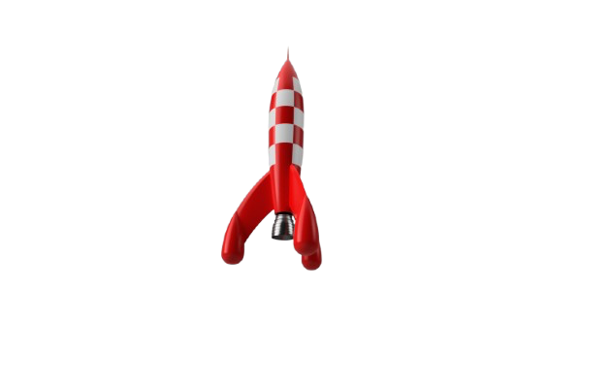
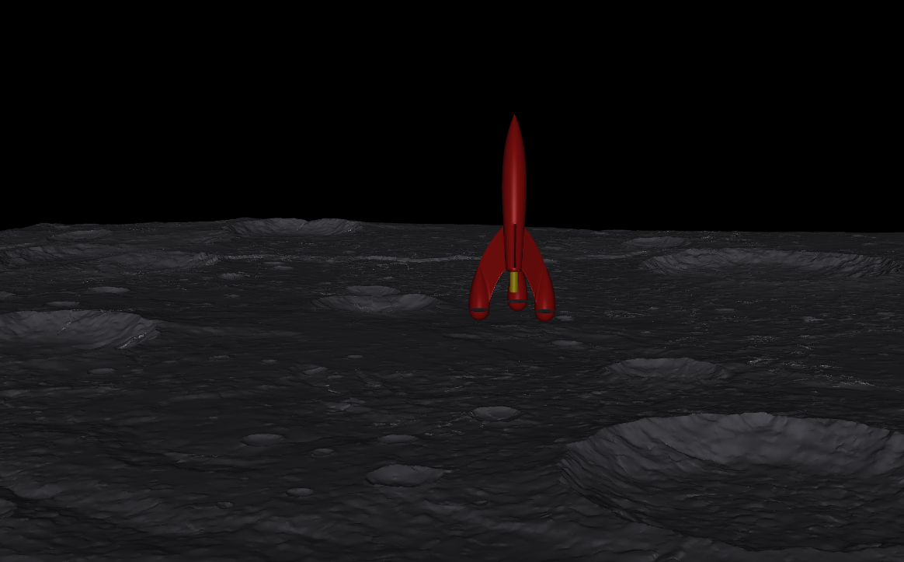
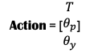
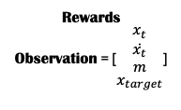
Action = [$\begin{matrix}T \\ θ_{p} \\ θ_{y}\end{matrix}$]
Agent
Rewards Observation = [$\begin{matrix}x_{t} \\ \begin{aligned}\dot{x_{t}} \\ m\end{aligned} \\ x_{target}\end{matrix}$]
Environment

Slide 7
awesome—here’s a clean 6-DoF point-mass + rigid-body model with exactly the 3 forces you asked for (gravity, thrust, drag), applied as you specified.
Frames & notation
{I}: inertial/world frame. Gravity and drag are expressed here.
{B}: rocket “inertia” (body) frame fixed to the vehicle, origin at the cylinder center (CoM). Height (h=1) m along (+\mathbf{e}_3^B).
{T}: throttle/thrust frame at the bottom of the cylinder, origin at the nozzle (or thrust application point). It can gimbal (2-DoF).
Rotations:
(R_{IB}\in SO(3)): rotates a vector from {B} to {I}.
(R_{BT}(\alpha,\beta)\in SO(3)): rotates from {T} to {B}; the gimbal angles (\alpha,\beta) are the control directions (choose any consistent 2-angle convention, e.g. yaw-pitch or pitch-yaw).
Kinematics:
Position ( \mathbf{p}\in\mathbb{R}^3) in {I}, velocity ( \mathbf{v}=\dot{\mathbf{p}}\in\mathbb{R}^3) in {I}.
Attitude (R_{IB}) (or quaternion (q)); body rates ( \boldsymbol{\omega}\in\mathbb{R}^3) in {B}.
Lever arm from CoM to throttle: ( \mathbf{r}_{TB} = \begin{bmatrix}0\0\-h/2\end{bmatrix} = \begin{bmatrix}0\0\-0.5\end{bmatrix}) (in {B}).
Controls: [ u ;=; \begin{bmatrix} u_T \ \alpha \ \beta \end{bmatrix} \quad\text{where } u_T\ge 0 \text{ is thrust magnitude.} ]
Mass & inertia (solid cylinder of radius (r), height (h=1)): [ I_B=\mathrm{diag}!\left(I_x,I_y,I_z\right),;; I_x=I_y=\frac{1}{12}m(3r^2+h^2),;;I_z=\frac{1}{2}mr^2 . ] (If you want propellant depletion, add (\dot m) as usual; otherwise treat (m) constant.)
Forces (only these three)
Gravity (in {I}): [ \mathbf{F}_g^I = m,\mathbf{g}, \quad \mathbf{g}=\begin{bmatrix}0\0\-g\end{bmatrix}. ]
Thrust (applied at {T}, expressed in {I}):
Unit thrust axis of {T}: (\hat{\mathbf{t}}^T=\mathbf{e}_3^T) (choose so that thrust on the vehicle is (+u_T\hat{\mathbf{t}}^T)).
In {B}: (\hat{\mathbf{t}}^B = R_{BT}(\alpha,\beta),\hat{\mathbf{t}}^T).
In {I}: (\hat{\mathbf{t}}^I = R_{IB},\hat{\mathbf{t}}^B).
Force: [ \mathbf{F}_T^I = u_T,\hat{\mathbf{t}}^I . ]
Moment about CoM (in {B}): [ \boldsymbol{\tau}T^B = \mathbf{r}{TB}\times \mathbf{F}_T^B \quad\text{with}\quad \mathbf{F}T^B = R{BI},\mathbf{F}_T^I = u_T,\hat{\mathbf{t}}^B . ]
Aerodynamic drag (through CoM, in {I}): Let (\hat{\mathbf{v}}=\frac{\mathbf{v}}{|\mathbf{v}|}) (if (|\mathbf{v}|>0)); air density (\rho); drag coefficient (C_D) (constant or angle-dependent); projected area (A_{\text{proj}}) along the flight direction (you said this is known from the state). [ \mathbf{F}D^I = -\tfrac{1}{2},\rho,|\mathbf{v}|^2,C_D,A{\text{proj}},\hat{\mathbf{v}}. ] (Acts at CoM ⇒ no drag torque.)
If you want an explicit projected area for a cylinder of radius (r) and axis (\mathbf{a}^I=R_{IB}\mathbf{e}3^B): with (\theta=\arccos(\mathbf{a}^I!\cdot!\hat{\mathbf{v}})), [ A{\text{proj}}(\theta)=\pi r^2,|\cos\theta| + 2rh,|\sin\theta|, \quad h=1. ]
Equations of motion
Translational (expressed in {I})
[ \dot{\mathbf{p}} = \mathbf{v}, \qquad m,\dot{\mathbf{v}} = \mathbf{F}_g^I + \mathbf{F}_T^I + \mathbf{F}_D^I . ]
Rotational
Attitude kinematics (choose one):
Rotation matrix: [ \dot{R}{IB} = R{IB},[\boldsymbol{\omega}]\times , \quad [\boldsymbol{\omega}]\times x = \boldsymbol{\omega}\times x. ]
or quaternion (q) (scalar-last): [ \dot q = \tfrac{1}{2},\Omega(\boldsymbol{\omega}),q, \quad \Omega(\boldsymbol{\omega})= \begin{bmatrix} 0 & -\boldsymbol{\omega}^\top\ \boldsymbol{\omega} & -[\boldsymbol{\omega}]_\times \end{bmatrix}. ]
Rigid-body dynamics in {B}: [ I_B,\dot{\boldsymbol{\omega}} + \boldsymbol{\omega}\times(I_B,\boldsymbol{\omega}) = \boldsymbol{\tau}^B, \qquad \boldsymbol{\tau}^B = \boldsymbol{\tau}T^B = \mathbf{r}{TB}\times\big(u_T,\hat{\mathbf{t}}^B\big). ]
Control mapping (gimbal)
Pick a 2-angle parameterization for (R_{BT}). One common choice (yaw-pitch about {B} axes at the throttle): [ R_{BT}(\alpha,\beta) = R_B(\mathbf{e}_2,,\beta),R_B(\mathbf{e}1,,\alpha) ] (or any fixed sequence you prefer). Then [ \hat{\mathbf{t}}^B(\alpha,\beta) = R{BT}(\alpha,\beta),\mathbf{e}_3^T . ]
Compact state-space form
Let the state be [ x=\begin{bmatrix}\mathbf{p}\ \mathbf{v}\ q \ \boldsymbol{\omega}\end{bmatrix} \quad\text{(or replace }q\text{ with }R_{IB}\text{)}, \qquad u=\begin{bmatrix}u_T\ \alpha\ \beta\end{bmatrix}. ] Then [ \dot{x} = \begin{bmatrix} \mathbf{v}[2mm] \frac{1}{m}\Big(m\mathbf{g} + u_T,R_{IB}\hat{\mathbf{t}}^B(\alpha,\beta) - \tfrac{1}{2}\rho |\mathbf{v}|^2 C_D A_{\text{proj}},\hat{\mathbf{v}}\Big)[2mm] \tfrac{1}{2}\Omega(\boldsymbol{\omega}),q[2mm] I_B^{-1}!\left(\mathbf{r}_{TB}\times\big(u_T,\hat{\mathbf{t}}^B(\alpha,\beta)\big) - \boldsymbol{\omega}\times(I_B\boldsymbol{\omega})\right) \end{bmatrix}. ]
(Optional) Mass depletion (if desired): [ \dot m = -\frac{u_T}{I_{sp},g_0}, ] and make (I_B) a function of (m) accordingly.
That’s the complete formulation under your assumptions: gravity & drag through the CoM in {I}, thrust applied at the bottom in {T} with a known transform to {B}/{I}, and the only moment is from the thrust lever arm plus gimbal direction.

Slide 8
